Slide 1
Programming Techniques Project Requirement F2018
Example Scenario: AddRectAction

Slide 2
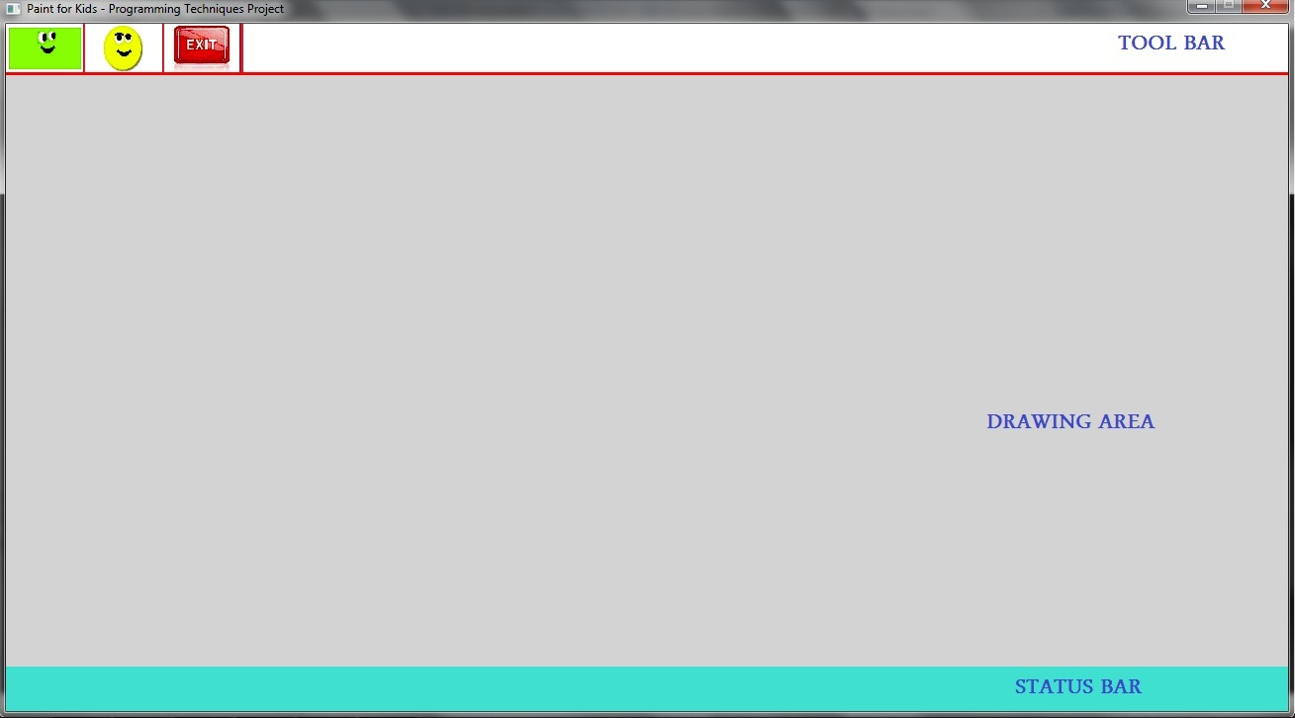
Drawing a new Rectangle
User Perspective
Application is waiting for user action
User clicks on ”Rectangle” icon
Messages appear on status bar and user selects two point (corners)
A rectangle is drawn
New Rectangle: Click at second corner
New Rectangle: Click at first corner

Slide 3
Steps to execute ANY operation
Application Perspective
4 basic steps to execute any operation:
Step I: Get User Input&Map to Action Type
Step II: Create Corresponding Action Object
Step III: Execute the Created Action
Now Action is complete but not reflected yet to GUI
Step IV: Update Interface

Slide 4
Drawing a Rectangle Steps Details
Step I: Get User Input & Map to Action Type
User clicks on “Rectangle” icon in the toolbar
Input class maps it to DRAW_RECT action type (enum)
Step II: Create Corresponding Action Object
Create Object of class AddRectAction
Step III: Execute the Created action
Ask user to click on two points (new rectangle corners)
Create Object of class CRectangle
Add the CRectangle object to the list of Figures ➔ Rect. is saved
Step IV: Update Interface
For each Figure in the list, call Draw function
Each Figure calls the appropriate draw function from Output class. CRectangle ::Draw calls Output::DrawRect ➔ Rect. is shown

Slide 5
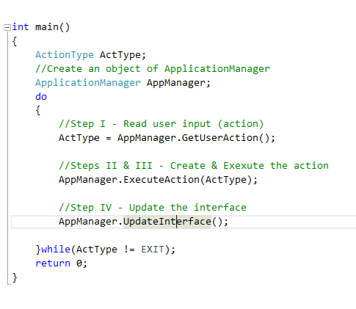
Step I: Get user input

Slide 6
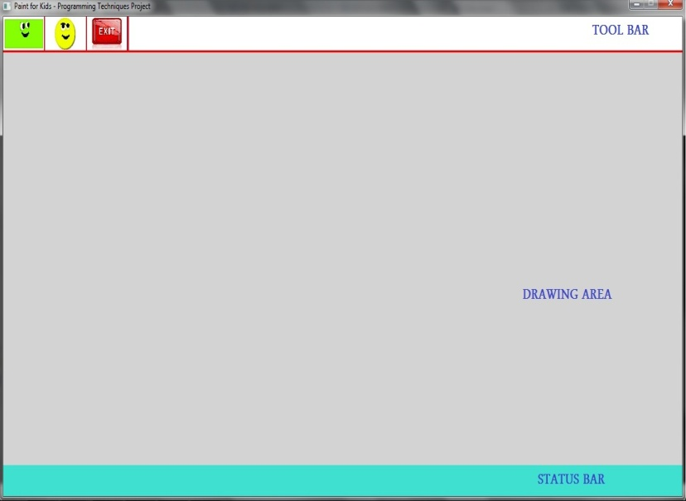
Step I: Get user input
ActionType:
DRAW_RECT
6
Main
Application Manager
AppManager.GetUserAction();
1
5
Returns:
DRAW_RECT
2
pIn->GetUserAction()
Click Rectangle icon
3
WaitMouseClick()
Input
Area Checking &
Action Recognition
4
(x, y)
Click Position

Slide 7
Step II: Create a suitable action Step III: Execute the action

Slide 8
Step II: Create corresponding action
1
AppManager.ExecuteAction(DRAW_RECT);
Main
ApplicationManager
ExecuteAction Function
pAct (pointer)
Action* pAct = NULL; //polymorphism
//switch-case ➔ create the action pAct = new AddRectAction(this);
2
NULL
AddRectAction (derived class)
ReadActionParameters( )
Execute( )
pAct->Execute(); //Action::Execute //is a pure virtual fn.
3

Slide 9

Step III: Execute the action (1/2) AddRectAction::ReadActionParameters()
pOut->PrintMessage(message);
//is Called twice
AddRectAction
- Gets pointers to I/O from AppMngr
1
Output
2
Print 2 messages on status bar
to ask user to click at Rect corners
3
pIn->GetPointClicked();
6
(x1, y1)
(x2, y2)
4
WaitMouseClick(x, y)
Input
User clicks at two corners
say(x1, y1) and (x2,y2)
(x1, y1) , (x2, y2)
Rect Corners
5

Slide 10
Step III: Execute the action (2/2) AddRectAction::Execute()
2
pManager-> AddFigure(R)
//ask the App. manager to add the Rect
to the list of Figures “FigList”
//polymorphism: CFigure * FigList[MaxFigCount];
Application Manager
CFigure* FigList[ ]
AddRectAction
Function Execute
//Create CRectangle Object
//RectGfxInfo stores draw color, fill color, etc
R = new CRectangle(P1, P2, RectGfxInfo)
CFigure *
CFigure *
CFigure *
CFigure *
CFigure *
CFigure *
CFigure *
1
CRectangle
(derived class)

Slide 11
Step IV: Reflect the action to the Interface

Slide 12
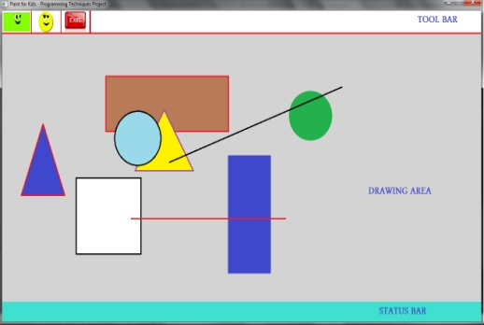
Step IV: Reflect the action to the Interface
Main
1
AppManager.UpdateInterface();
Application Manager
FigList [ ]
For each figure in the list
FigList[i]->Draw(pOut);
//CFigure::Draw() //is a pure virtual fn.
2
CFigure *
CFigure*
CFigure*
CFigure*
CFigure*
CFigure*
CFigure*
CRectangle
(derived class)
3
pOut->DrawRect(…);
Output
All figures
are drawn
5
4

Slide 13
Thank You ☺

